Slide 1

Python Data Structures

Slide 2
Objectives
Understand the str class
Write structures with correct keys and values to demonstrate understanding of dictionaries.
Work with and perform operations on dictionaries in Python.
Create sets to demonstrate understanding of the differences between sets, tuples, and lists.
Work with sets in Python, including operations and logic operations
Python Data Structures

Slide 3
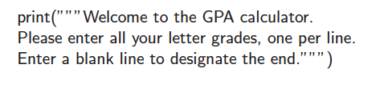
The str Class
String literals can be enclosed in single quotes, as in ‘hello’, or double quotes, as in "hello".
A string can also begin and end with three single or double quotes, if it contains newlines in it.
Python Data Structures

Slide 4
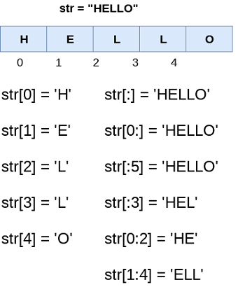
The str Class
Python Data Structures

Slide 5
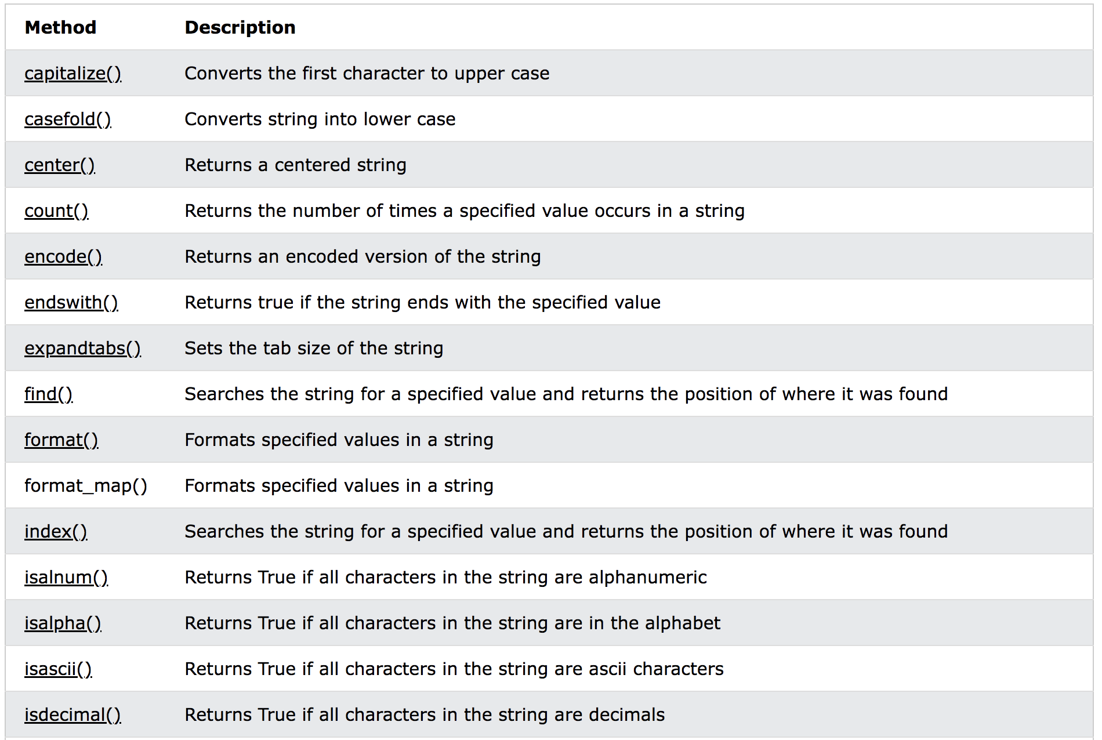
The str Class
Python Data Structures

Slide 6
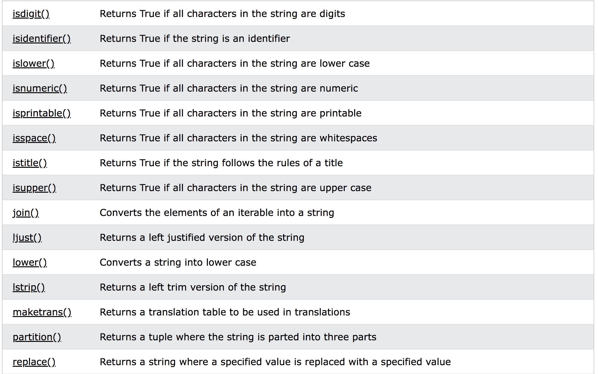
The str Class
Python Data Structures

Slide 7
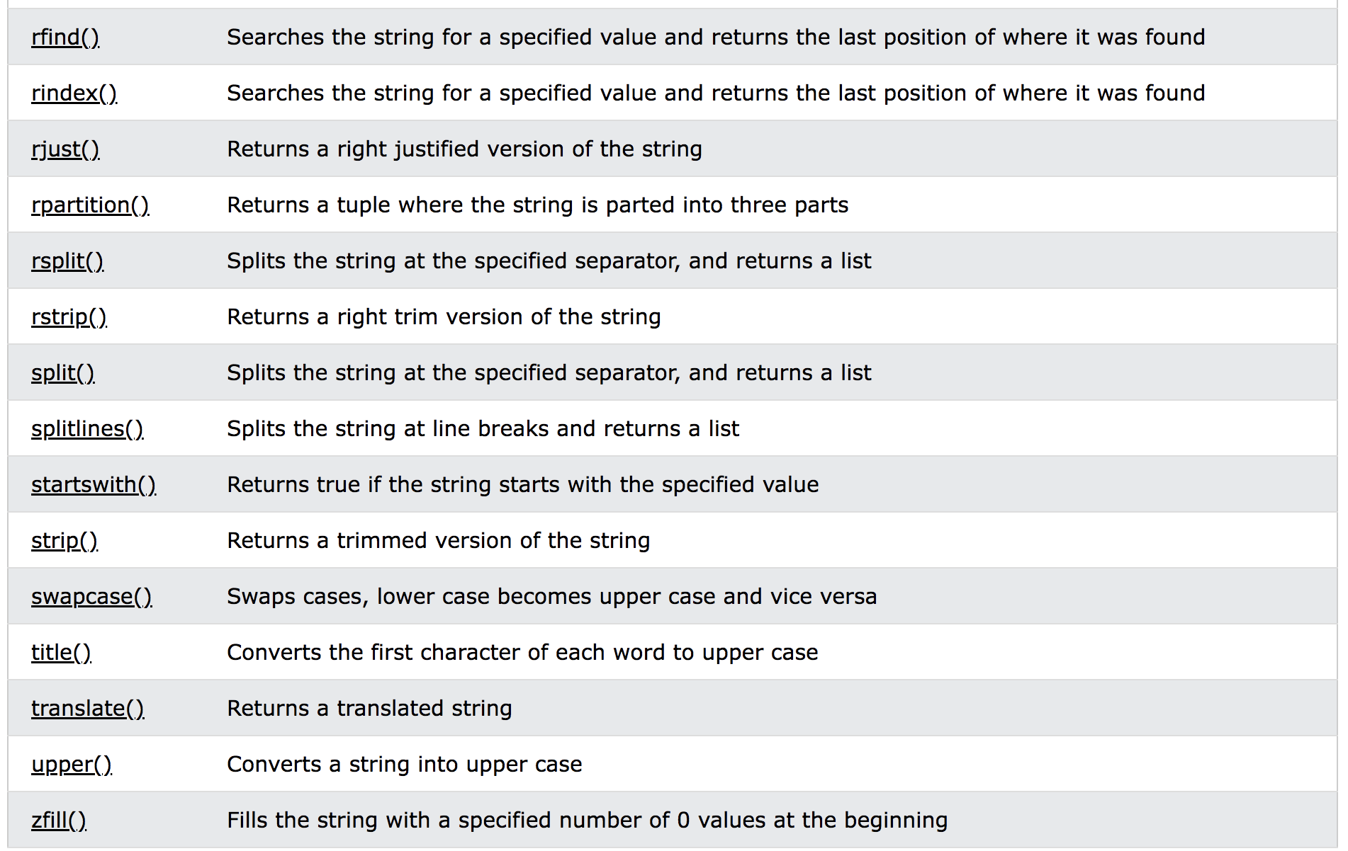
The str Class
Python Data Structures

Slide 8
The set Class
Python’s set class represents a set, namely a collection of elements, without duplicates, and without an inherent order to those elements.
Only instances of immutable types can be added to a Python set. Therefore, objects such as integers, floating-point numbers, and character strings are eligible to be elements of a set.
  The frozenset class is an immutable form of the set type, itself.
Python uses curly braces { and } as delimiters for a set
  For example, as {17} or {‘red’, ‘green’, ‘blue’}
  The exception to this rule is that { } does not represent an empty set. Instead, the constructor set( ) returns an empty set.
Python Data Structures

Slide 9
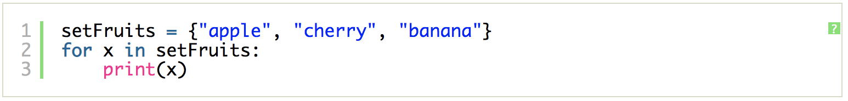
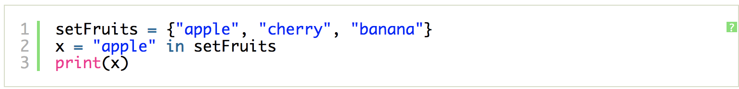
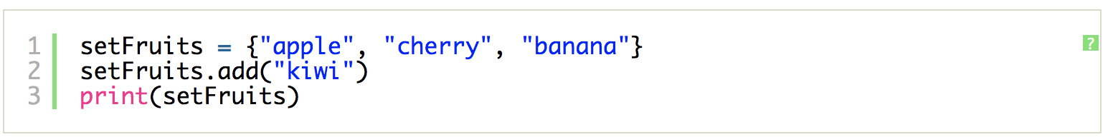
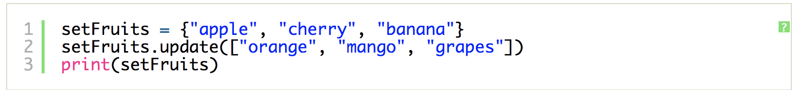
The set Class
Python Data Structures

Slide 10
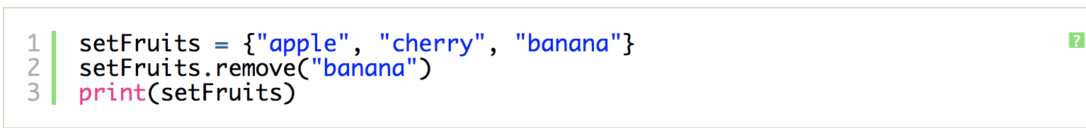
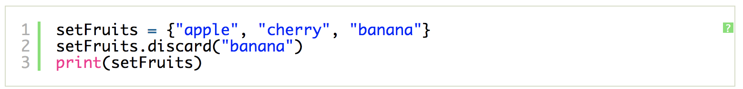
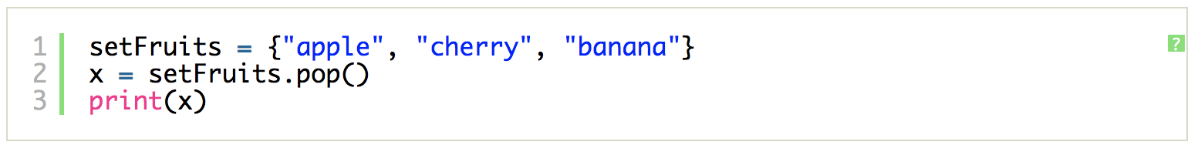
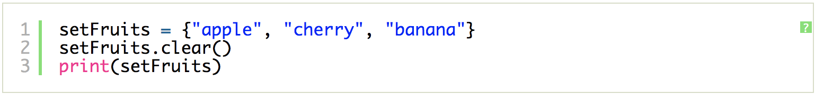
The set Class
Python Data Structures

Slide 11
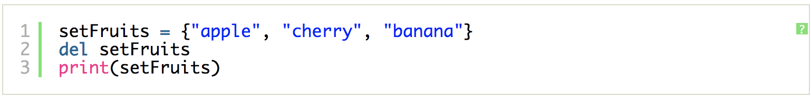
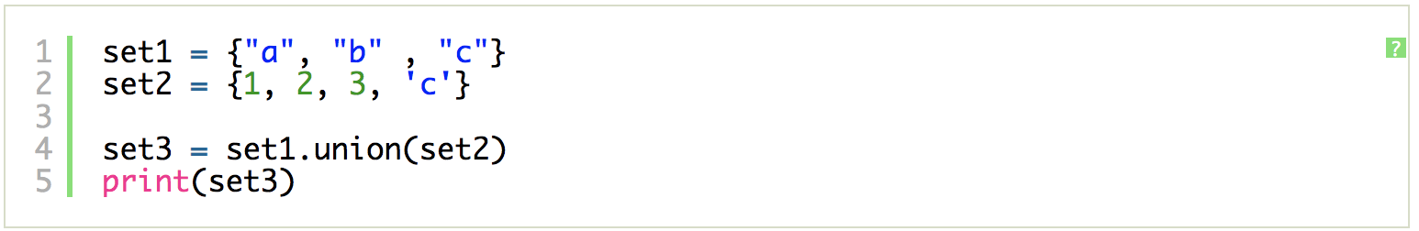
The set Class
Python Data Structures

Slide 12
The dict Class
Python’s dict class represents a dictionary, or mapping, from a set of distinct keys to associated values.
Python implements a dict using an almost identical approach to that of a set, but with storage of the associated values.
  The literal form { } produces an empty dictionary.
A nonempty dictionary is expressed using a comma-separated series of key:value pairs. For example, the dictionary {‘ga’ : ‘Irish’, ‘de’ : ‘German’} maps ‘ga’ to ‘Irish’ and ‘de’ to ‘German’.
Alternatively, the constructor accepts a sequence of key-value pairs as a parameter, as in dict(pairs) with pairs = [(‘ga’, ‘Irish’), (‘de’, ‘German’)].
Python Data Structures

Slide 13
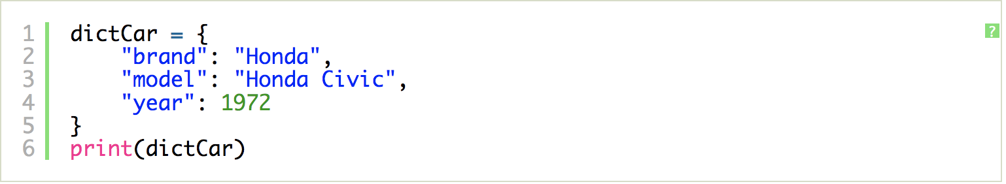
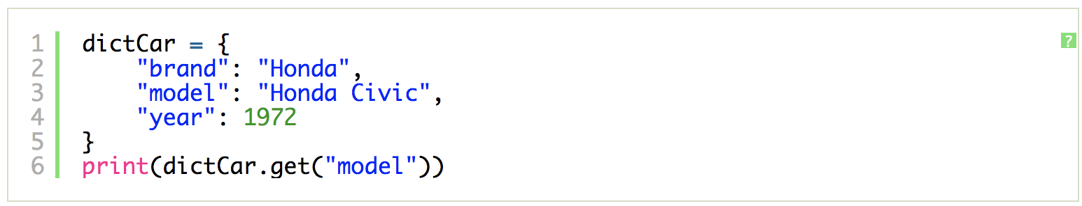
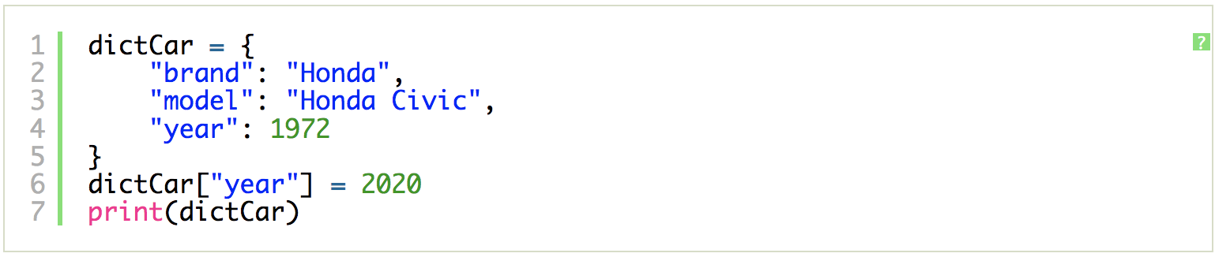
The dict Class
Python Data Structures

Slide 14
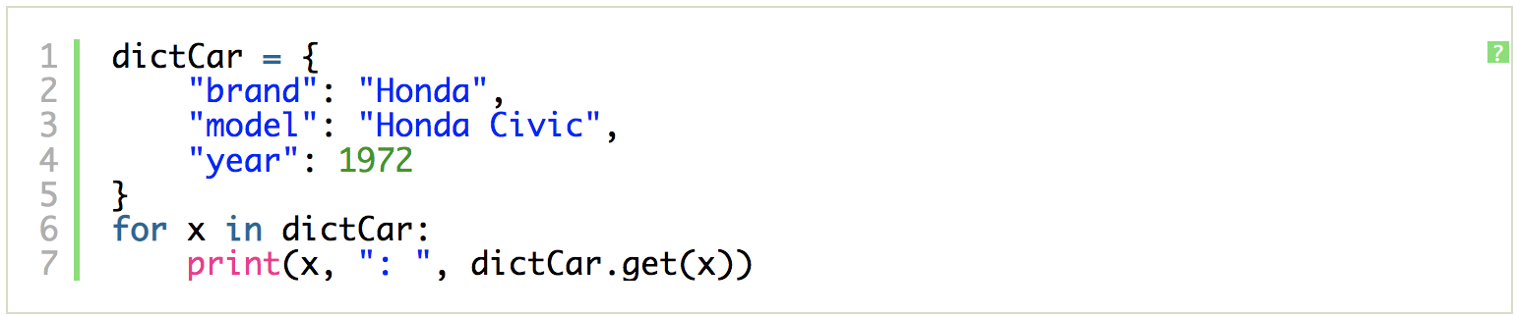
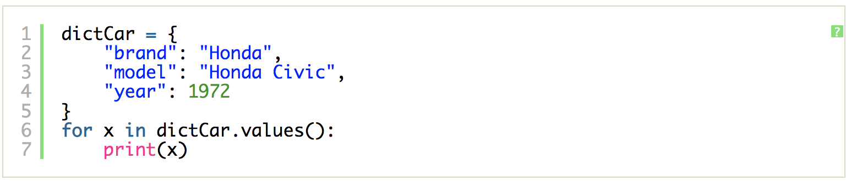
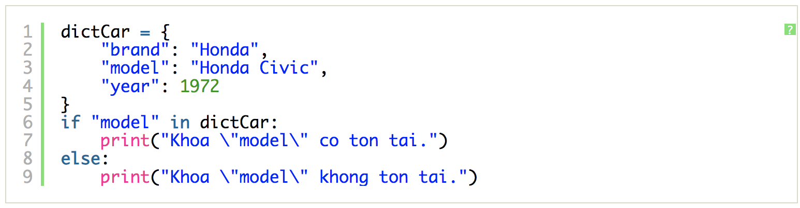
The dict Class
Python Data Structures

Slide 15
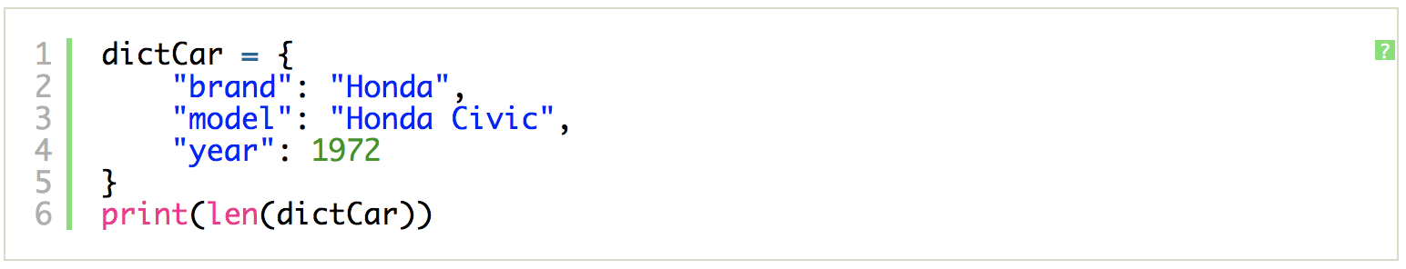
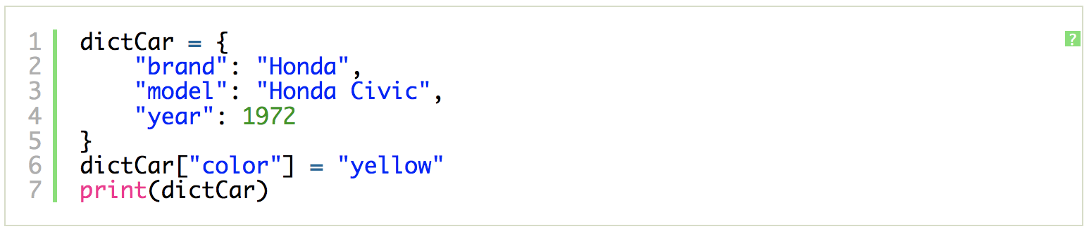
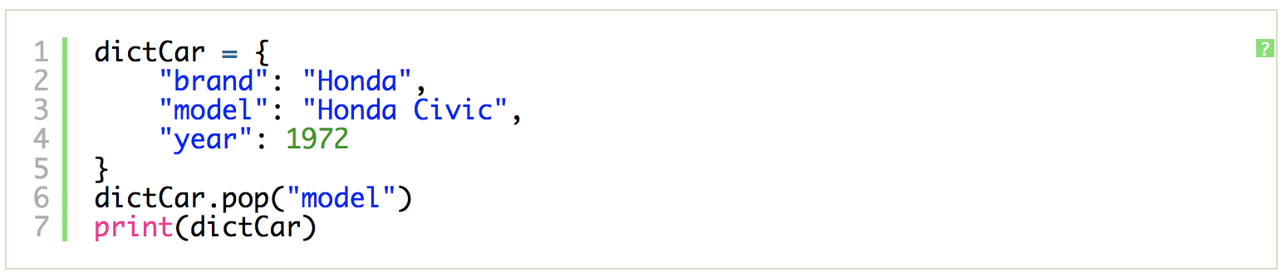
The dict Class
Python Data Structures

Slide 16
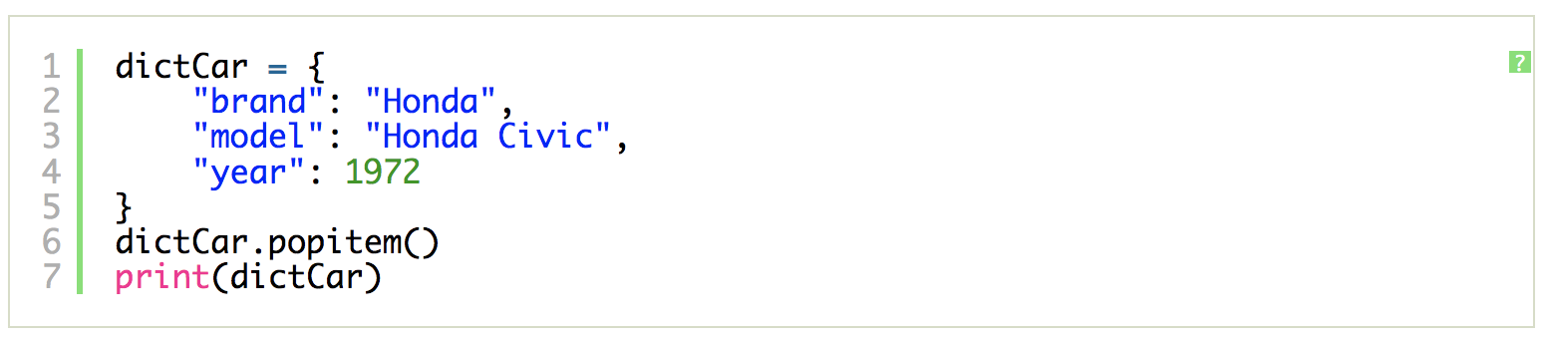
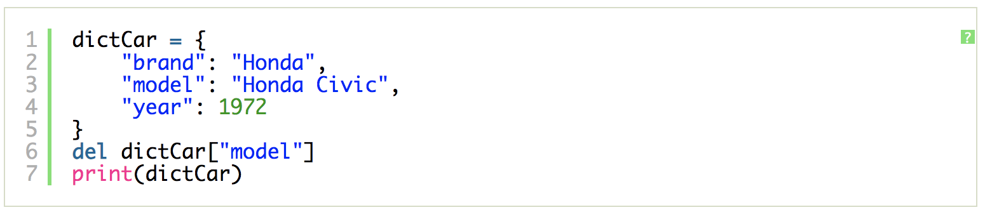
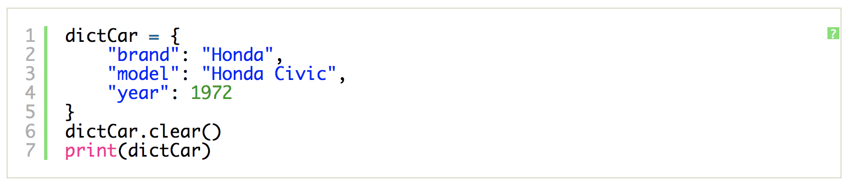
The dict Class
Python Data Structures

Slide 17
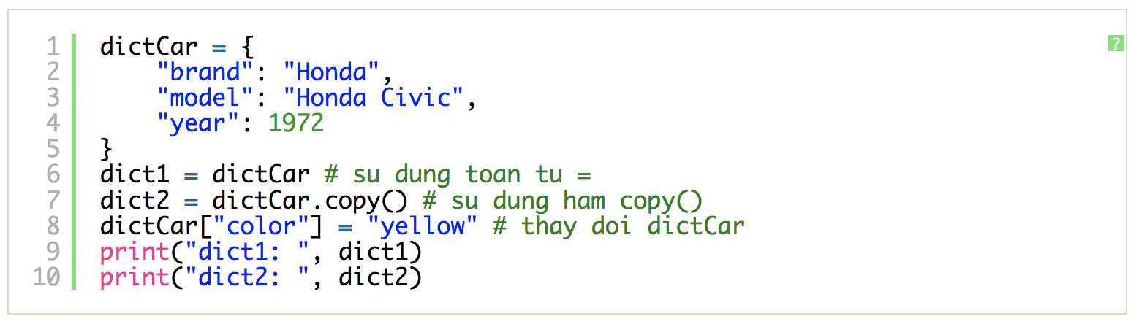
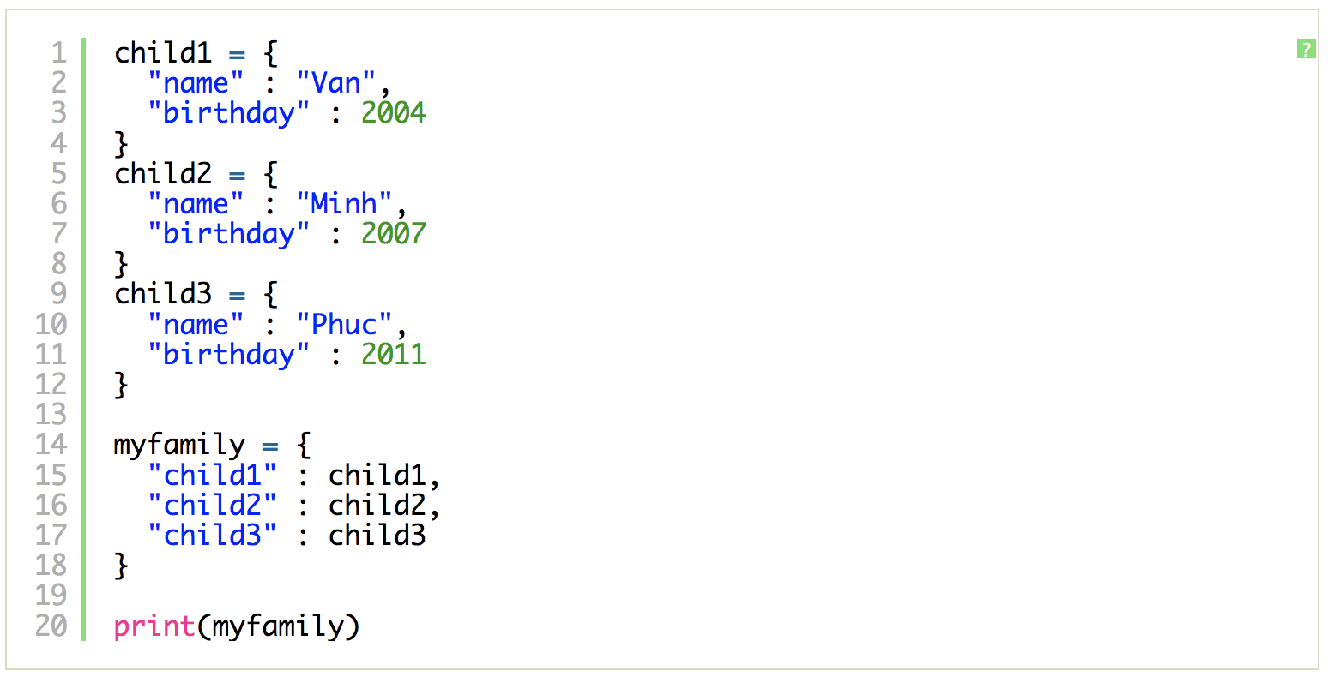
The dict Class
Python Data Structures

Slide 18
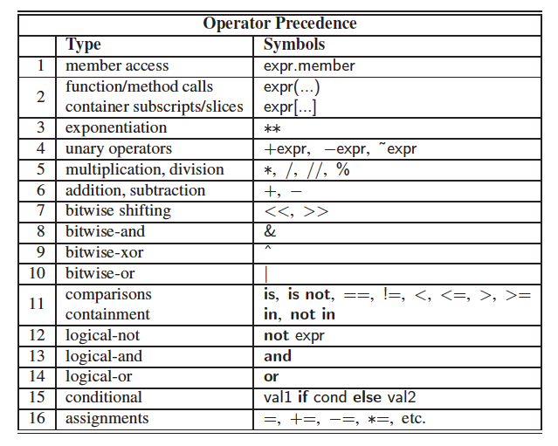
Operator Precedence
Python Data Structures

Slide 19
Summary
Understand the str class
Write structures with correct keys and values to demonstrate understanding of dictionaries.
Work with and perform operations on dictionaries in Python.
Create sets to demonstrate understanding of the differences between sets, tuples, and lists.
Work with sets in Python, including operations and logic operations
Python Data Structures

Slide 20
Q & A
Python Data Structures

